Slide 1
Software Engineer
Profession

Slide 2
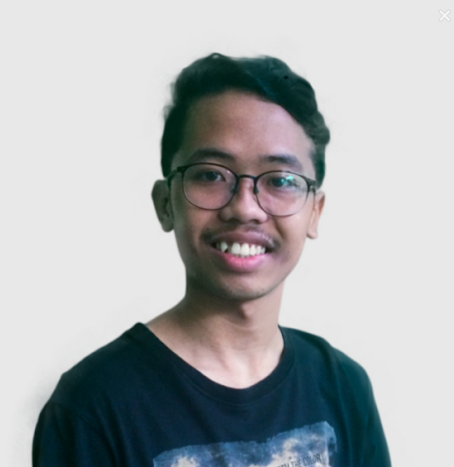
Siapa Gue ?
Erza Putra Albasori ERZ

Slide 3

Anggota Daspro Baru ?
Mas DP ( Mas DasPro )

Slide 4









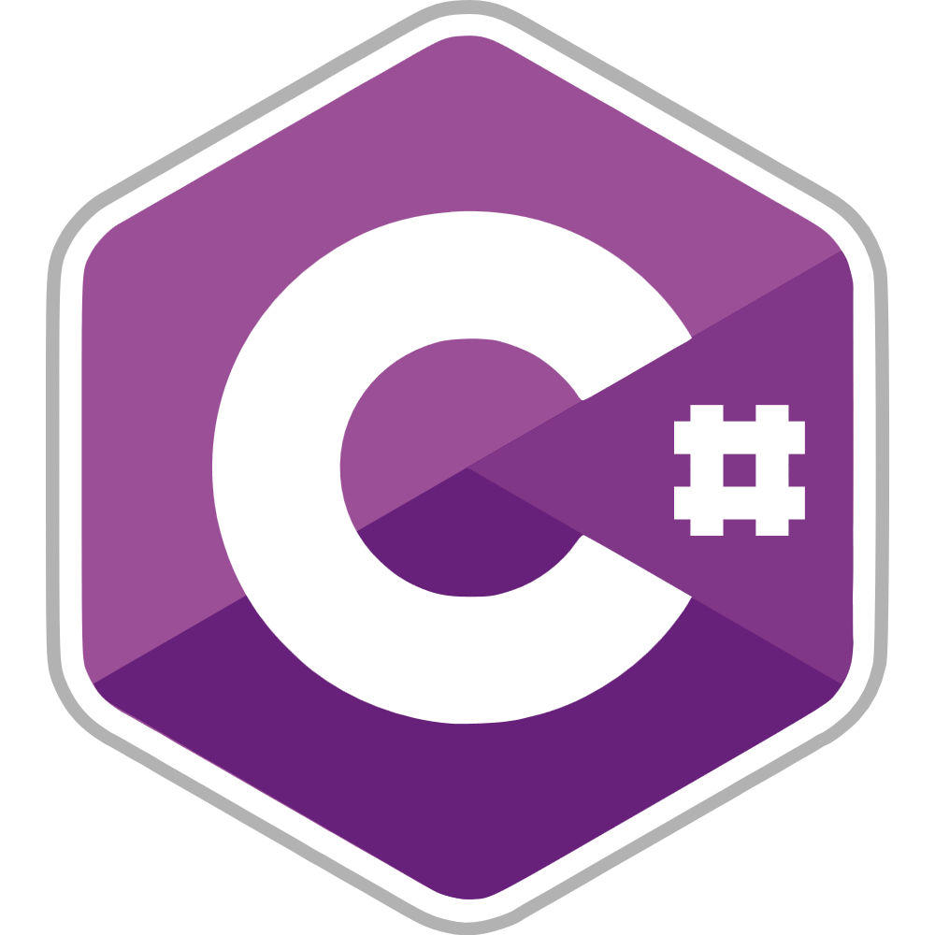


Seberapa Programmernya Anda ?
Source : image.google.com

Slide 5


















Seberapa Programmernya Anda ?
Source : image.google.com

Slide 6
Gimana cara jadi software engineer ?

Slide 7
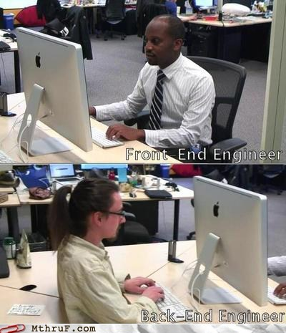
Software Engineer
Dev-ops Engineer
Front-end Engineer
Back-end Engineer

Slide 8
Apa yang harus Mas DP lakukan ?

Slide 9
Choose Your Role
Estetika
Front-end Engineer
Penempatan Posisi ( Layout )
Ngoding langsung keliatan
Ngoding gak langsung keliatan
Back-end Engineer
Fungsionalitas
Logika

Slide 10
Apa yang harus Mas DP lakukan ( lagi ) ?

Slide 11
Pick Your Programming Language !

Slide 12
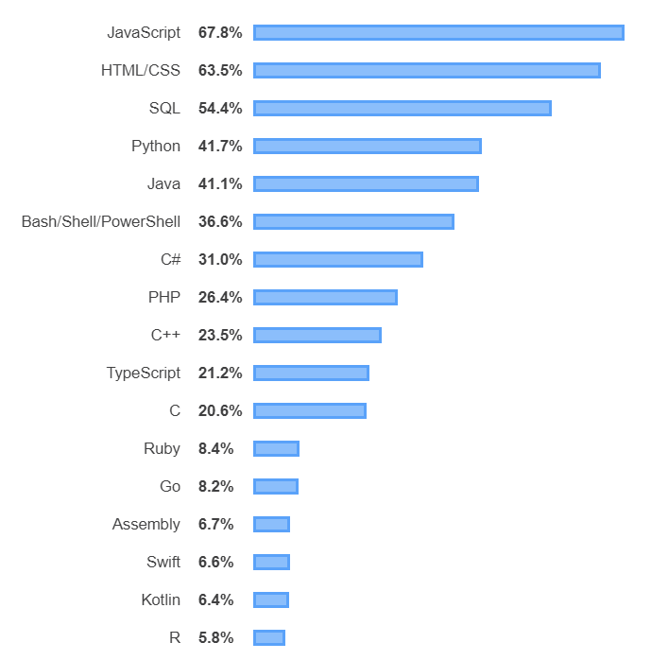
Programming, Scripting, and Markup Languages Trends
Source : insight.stackoverflow.com

Slide 13
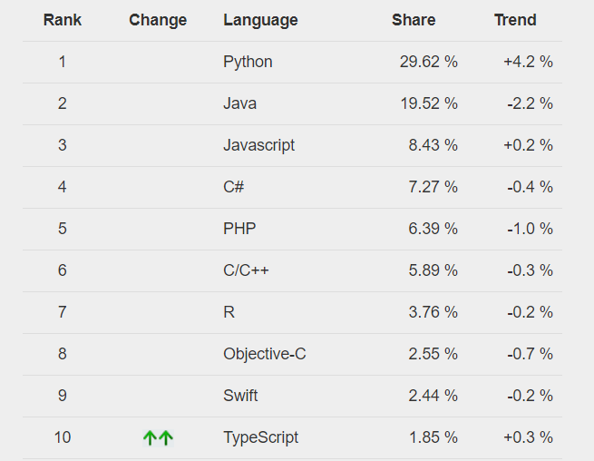
Programming Languages Trends
Source : pypl.github.io

Slide 14
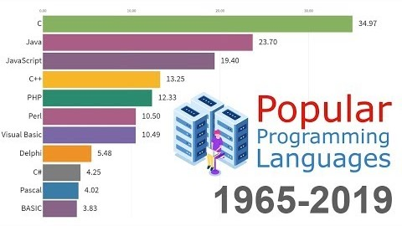
Programming Languages Trends
Source : https://www.youtube.com/watch?v=Og847HVwRSI

Slide 15
Apakah kita semua harus memilih sesuai Trends ?

Slide 16
GAQ !

Slide 17
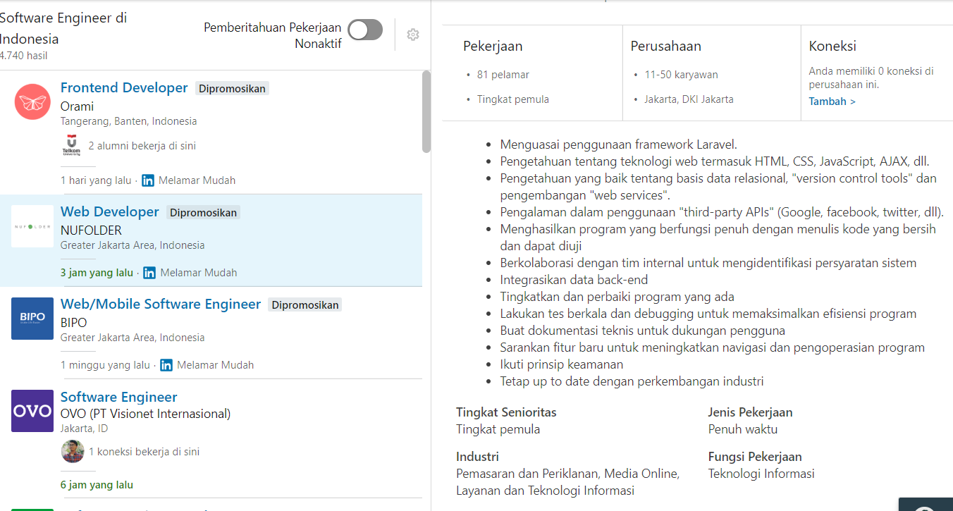
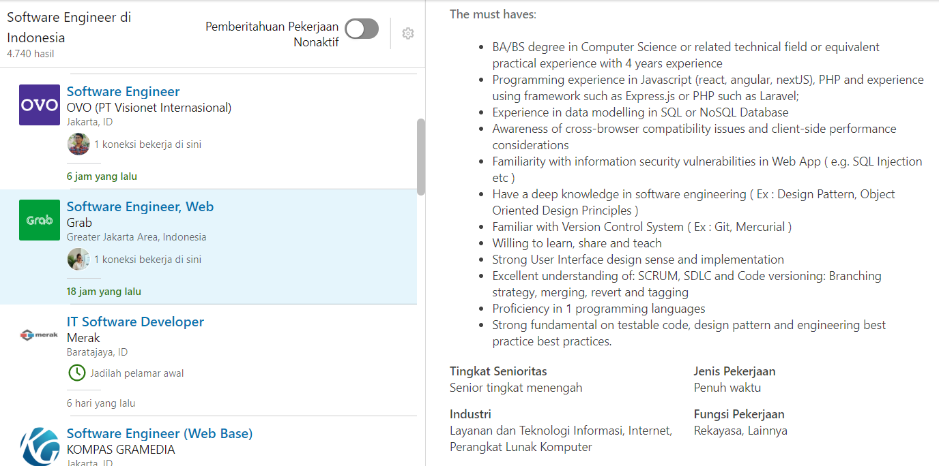
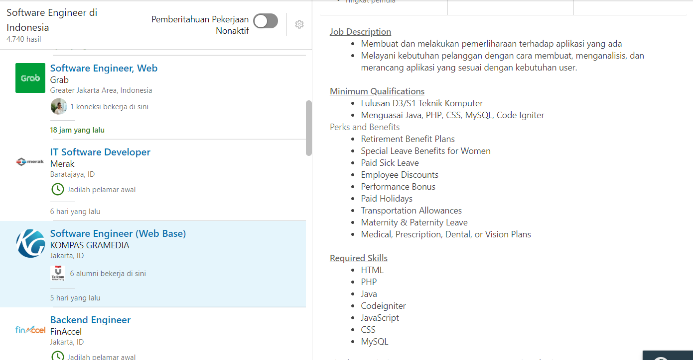
Software Engineer’s Job Requirements
Source : https://www.linkedin.com/jobs

Slide 18
Keep Learning
Terima Kasih

